Slide 1
Road Maker
By : Group 6( Don Jose,
Dominic K Savio,
Alen Varghese,
Shanu P Shaji)

Slide 2
Problem Statement
Potholes are not being fixed in a feasible time frame
We plan to find and prioritize which pothole needs to be fixed

Slide 3
Objectives
a)CrowdSource the data
b)Analyse the data
c)prioritize it to hotspots

Slide 4
Front end
User Registration
Admin Panel
CRUD operation done
HTML integration in Django web framework done
CSS integration in Django web framework done
Javascript integration in Django web framework done
Tested in Django Server
Postgres server intergration done

Slide 5
Inside the web framework
Checked the integrity using forms
Implemented in the Django server
Tested against the Cross-Site Request Forgery

Slide 6
Database
Implemented the database schema partially
Tested using the postgres database server
CRUD operation done

Slide 7
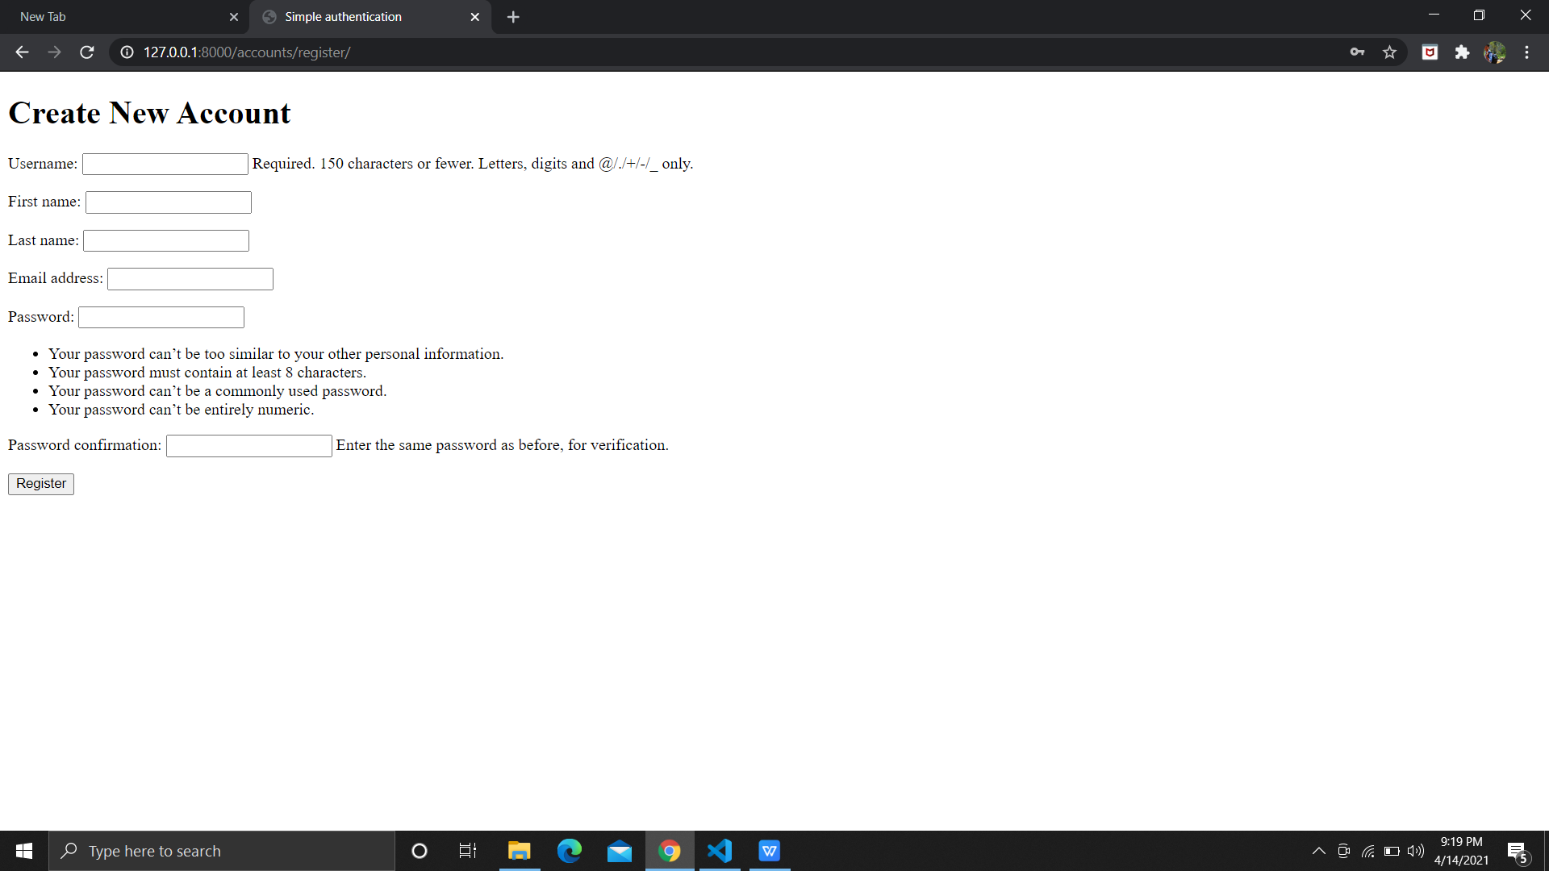
User Registration

Slide 8
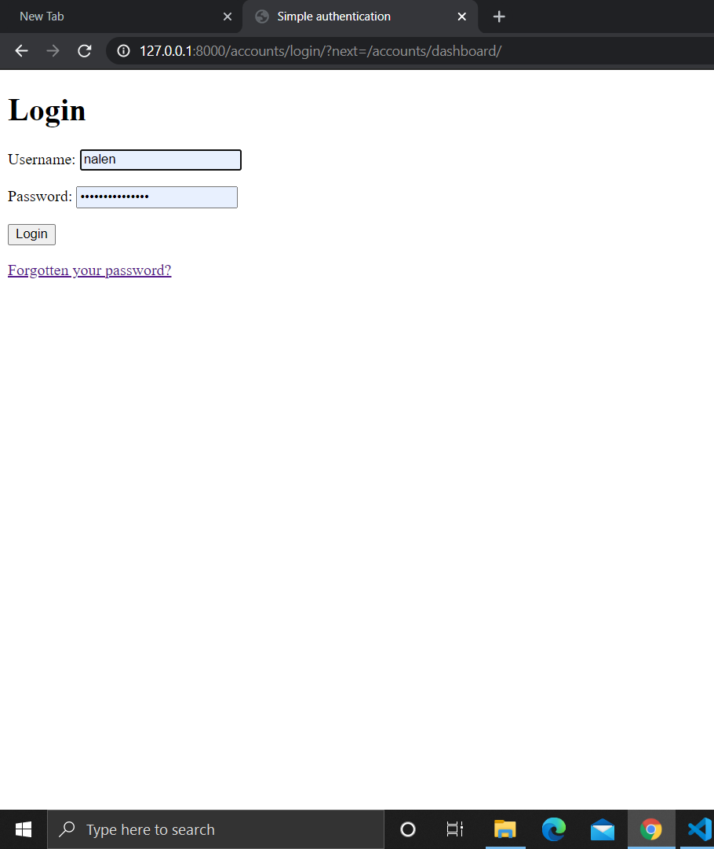
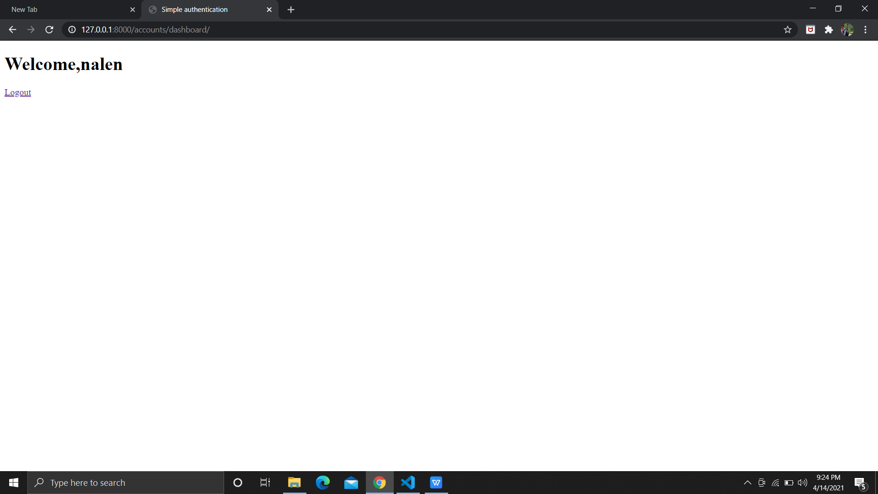
Login and Logout

Slide 9
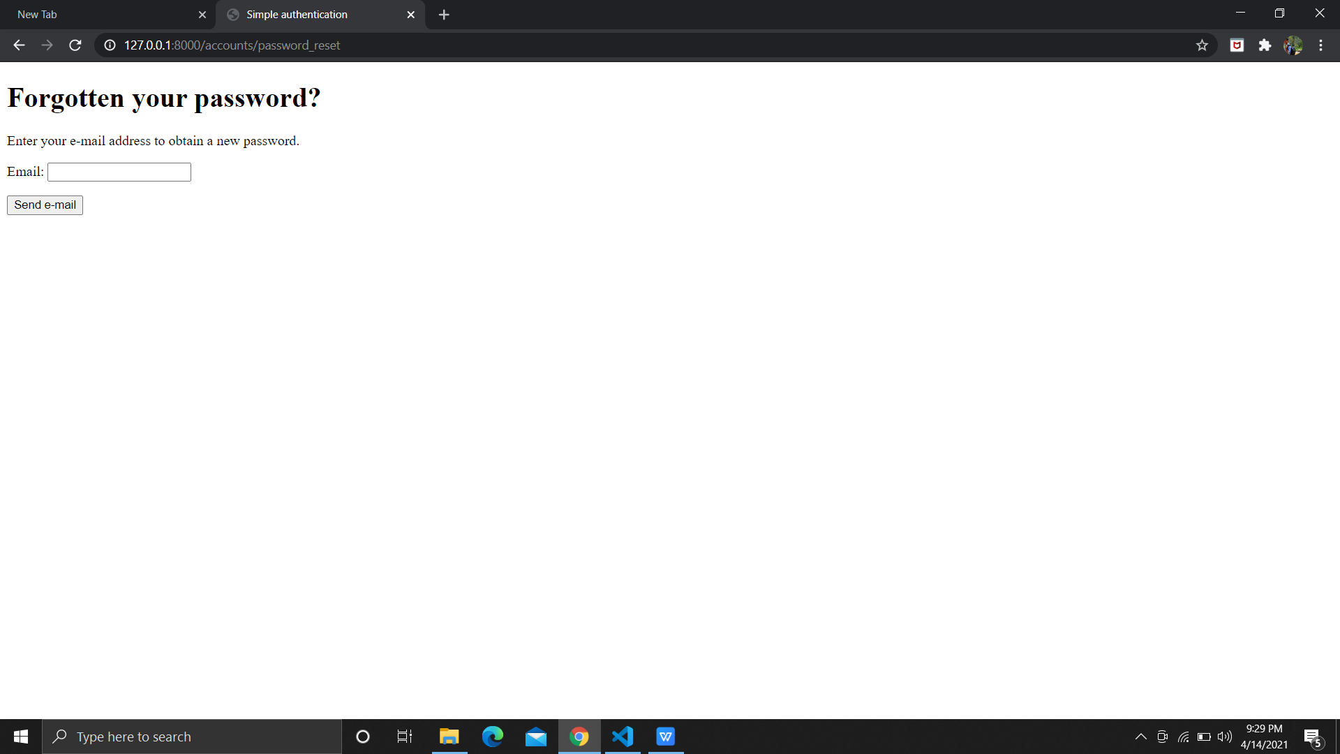
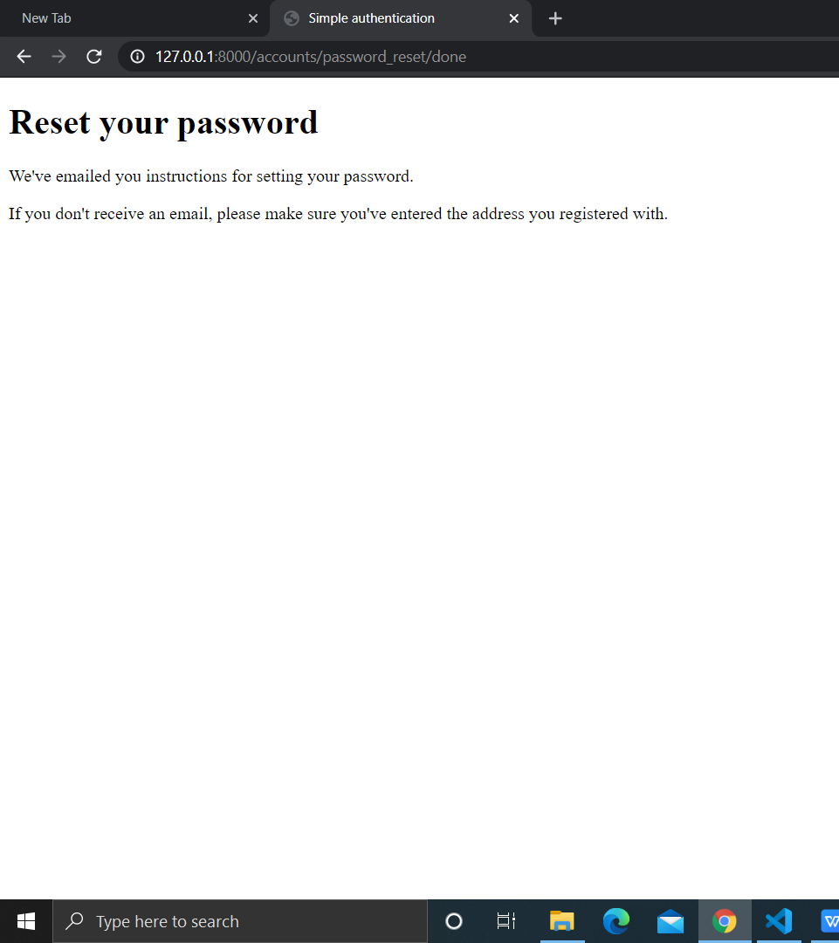
Forgot Password

Slide 10
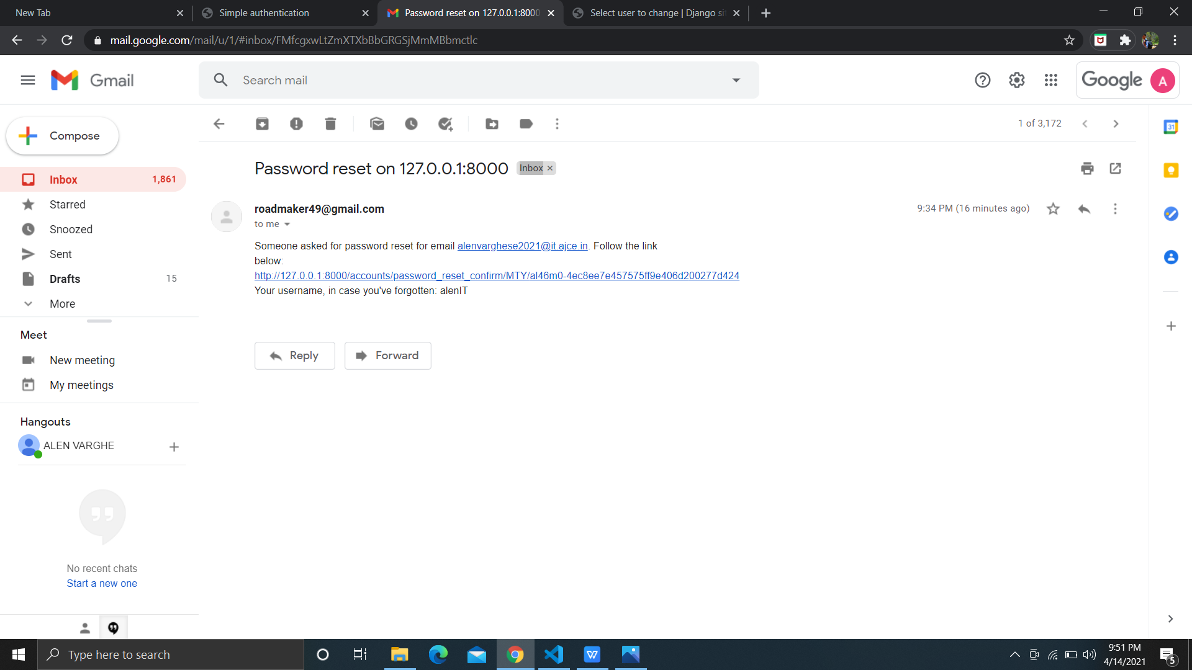

Slide 11
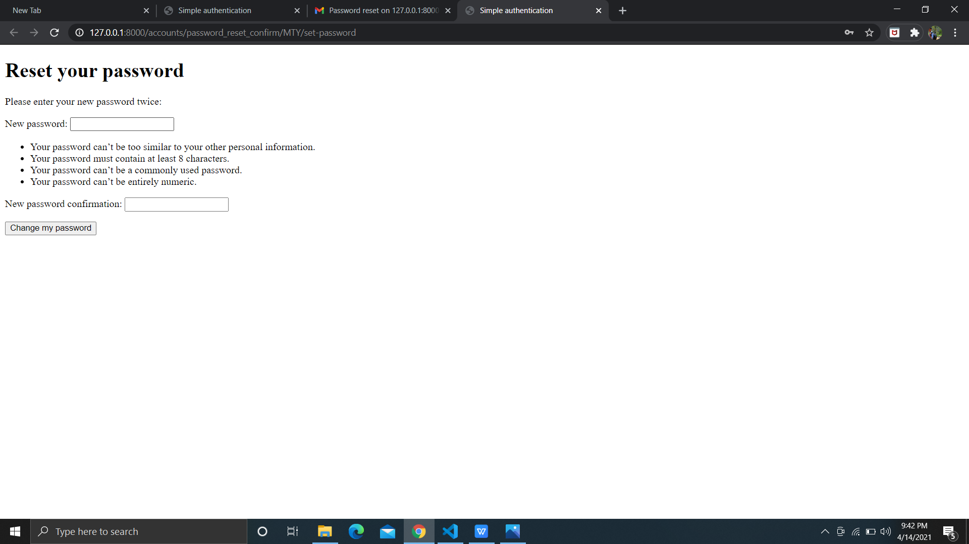

Slide 12
Clustering
Checked various algorithms
Evaluated each algorithm's accuracy
Selected DBSCAN
Clustering done using sample data sets
Evaluated its accuracy and found satisfactory
Analyzed the data

Slide 13
